Slide 1
Is this Article Scholarly?
So you have to write a paper or give a presentation, and your professor wants you to find articles from something called a “scholarly” or “peer-reviewed” journal. This brief tutorial will help you determine whether or not the article you have found meets that requirement.

Slide 2

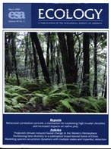

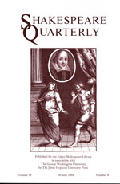
Examples of Scholarly Journals
These are all examples of “scholarly” or “peer-reviewed” journals. How can you tell? The best way is to take a look inside.

Slide 3
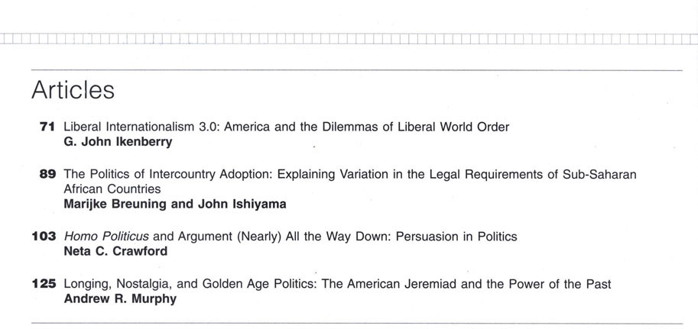
Table of Contents
Scholarly articles are usually somewhat lengthy, and their titles (which are also lengthy!) are more informative than eye catching.

Slide 4
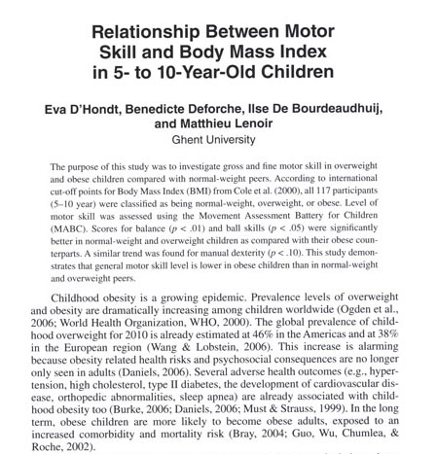
First Page of the Article
Articles in scholarly journals usually begin with an abstract that summarizes the contents of the article. Research articles are often broken down into sections labeled method, results, discussion, and recommendations for future research.

Slide 5

First Page of the Article – Pt. 2
Scholarly articles are written by experts or specialists in the field, and their credentials are usually included.

Slide 6
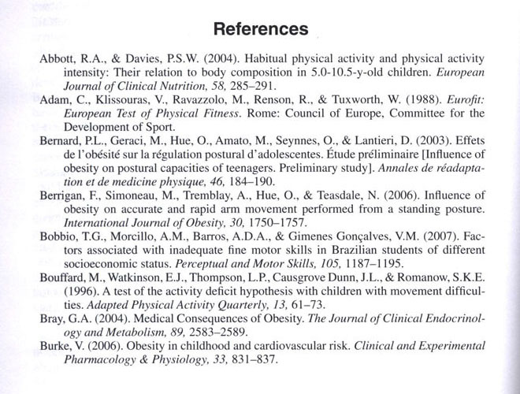
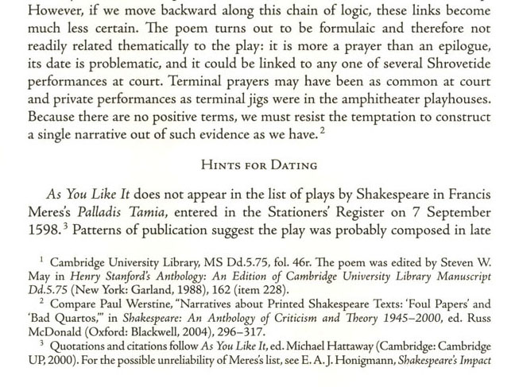
Bibliography
Articles in scholarly journals always have either a bibliography (above left) or footnotes (above right) that include references to other sources.

Slide 7
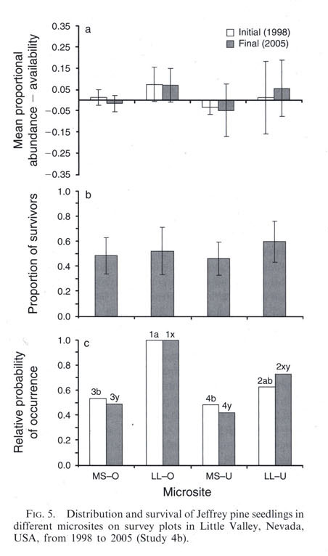
More Characteristics of Scholarly Articles
Written to present research findings and theories related to a particular field or discipline
Written for scholars and other academics, using jargon specific to the field
Illustrations are most often in the form of charts or graphs and provide support for the text

Slide 8





Tips about Library Databases
If you’re searching in one of these databases, you can be sure the articles you find are scholarly.

Slide 9
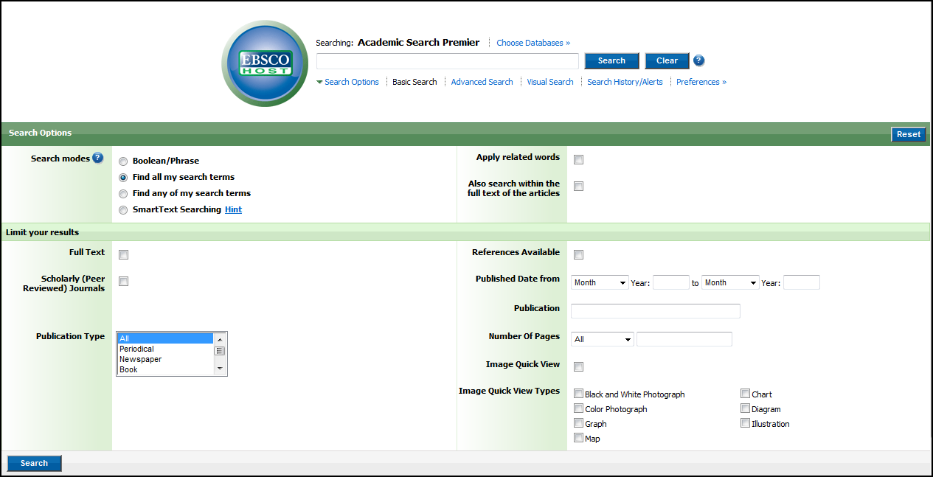
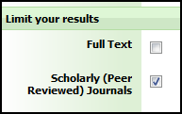
Library Databases – Pt. 2
In any of the EBSCOhost databases, you can limit your search to scholarly journals.

Slide 10
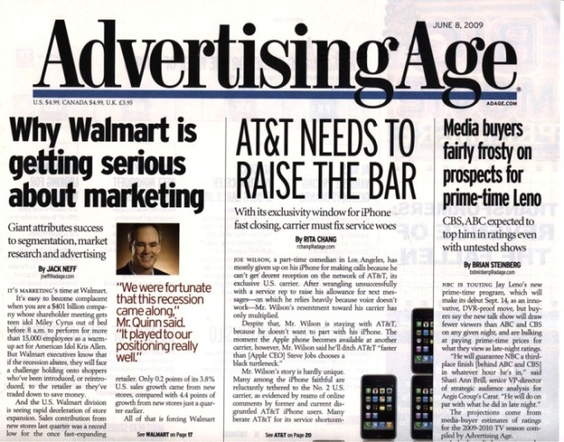
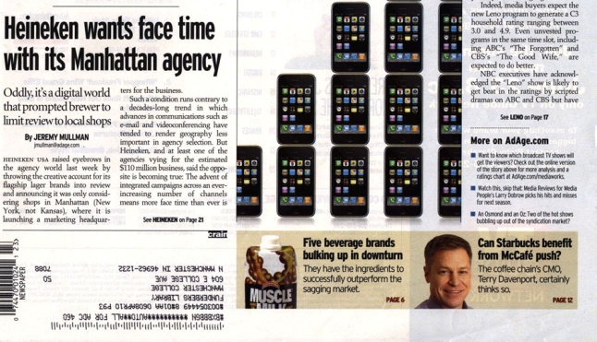
Other Types of Articles
During your research, you may come across articles from practitioner journals, also known as trade magazines.

Slide 11
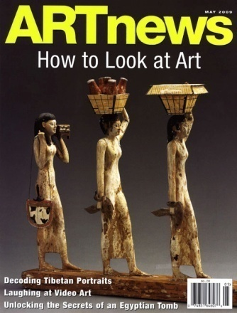
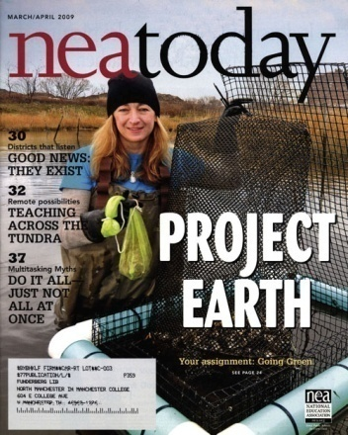
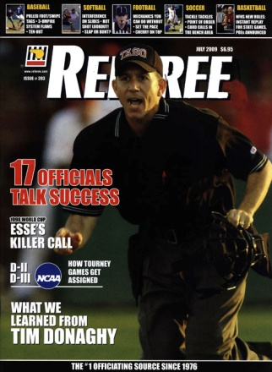

Practitioner Journals
Written by a practitioner in the field or specialized journalist
Report on news and trends in a particular industry or business
Provide advice to people who work in a particular field

Slide 12
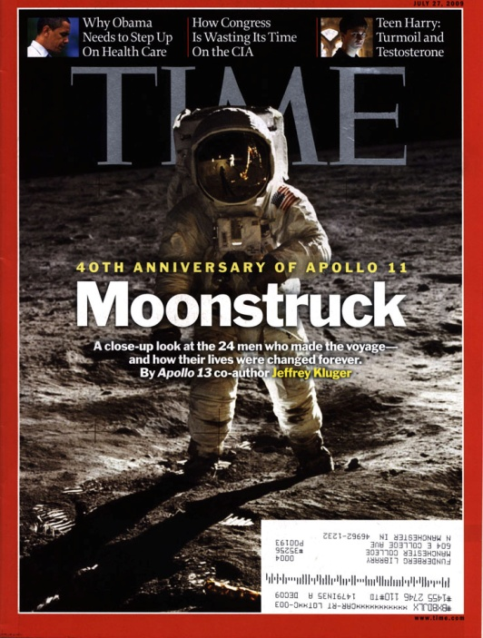
Other Types of Articles – Pt. 2
You’re probably already familiar with the third type of article you will find in popular magazines.

Slide 13

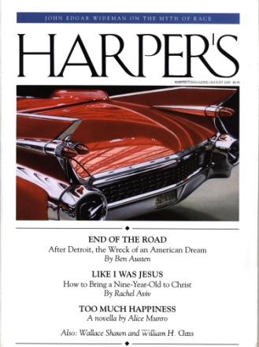
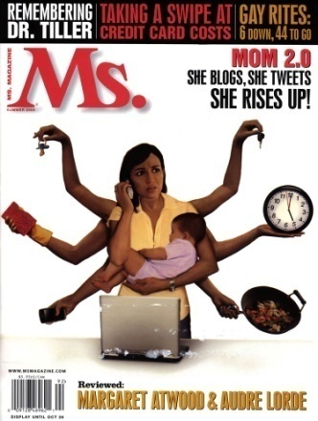
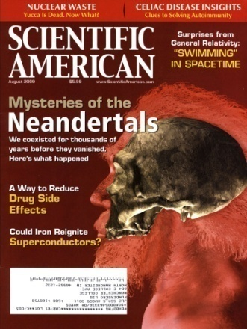
Popular Magazines
Written by a staff writer or journalist
Written to inform and entertain
Covers popular issues and popular culture
Written for a general, mass audience

Slide 14
Is Your Article Scholarly?
If you’re still not sure if you have a scholarly article, compare it to the information on slides 3-7, talk to your professor, or ask one of the librarians , either in person or at Ask a Librarian.

